Slide 1
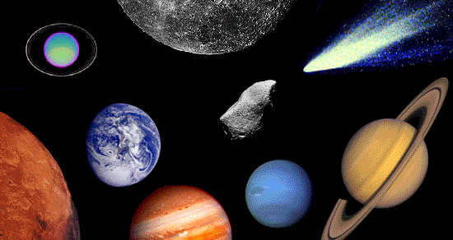
Introduction to Outer Space
Astronomy is the branch of science that studies objects beyond the Earth.
Any object in space- for example the Sun or the Moon is considered to be a celestial object .

Slide 2
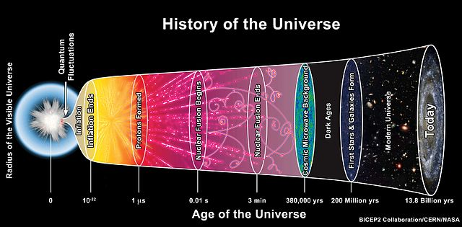
The universe is everything that exists, including all energy, matter and space.
Cosmology is the study of the universe.
It is believed to be 93 billion light years in diameter and 13.8 billion years old (Big Bang Theory)

Slide 3
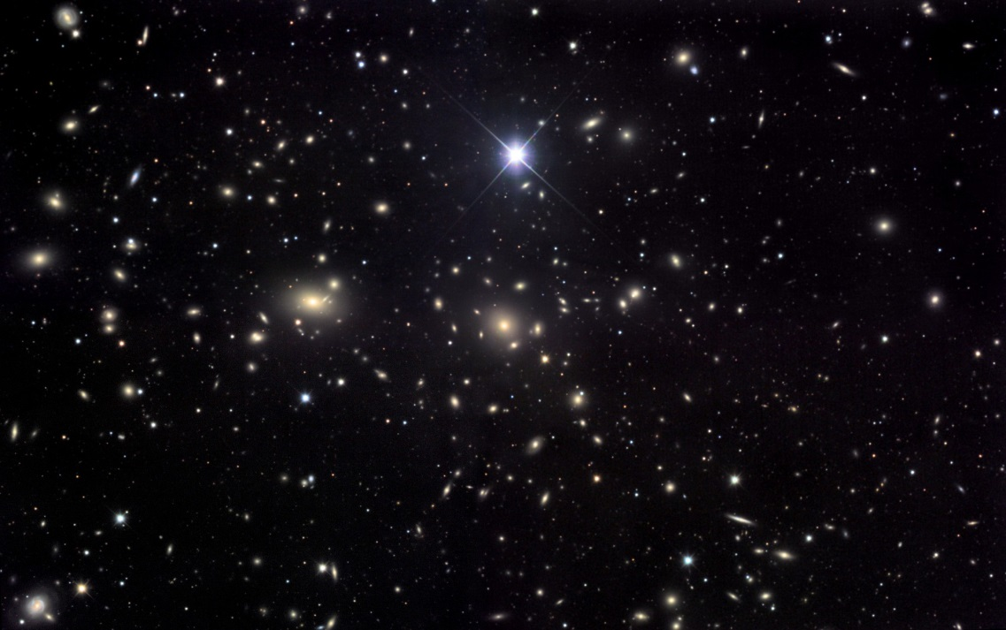
Stars are massive collections of gases held together by their own gravity and emitting huge amounts of energy.
Stars are luminous – meaning they produce and emit their own light.
Stars appear to be very small to the naked eye and this is because they are extremely far away.

Slide 4
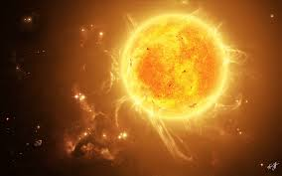
Our star (the Sun) is approximately 150,000,000 km away from Earth.
Travelling at 100km/h non stop, it would take approximately 171 years to get to the Sun.

Slide 5
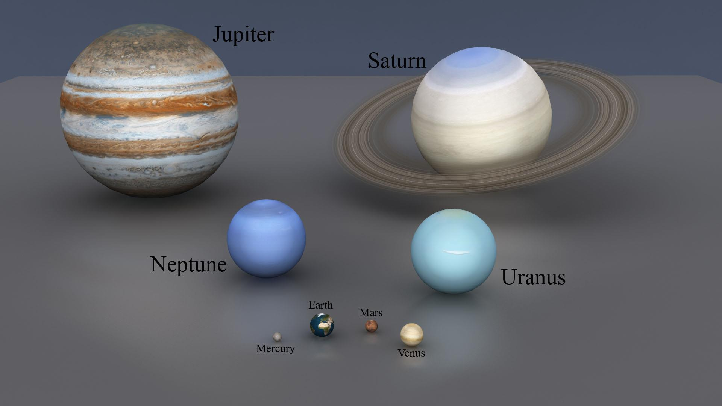
Planets are large celestial objects that revolve (travel) around a star and are non-luminous (reflect but do not emit light)
There are 8 planets in our solar system that revolve the sun.

Slide 6
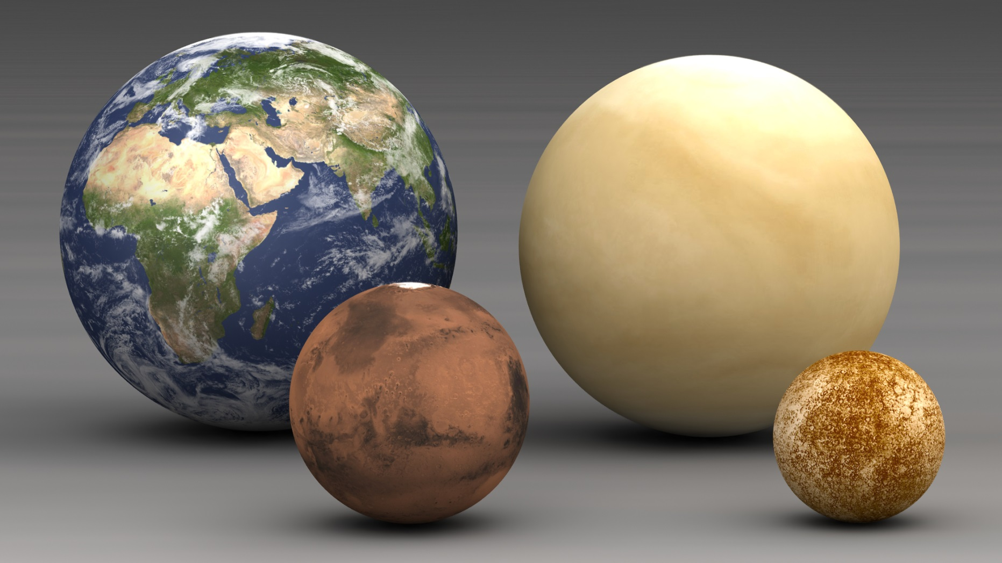
Mercury, Venus, Earth, Mars are the inner planets known as terrestrial planets as they have a solid rocky core.

Slide 7
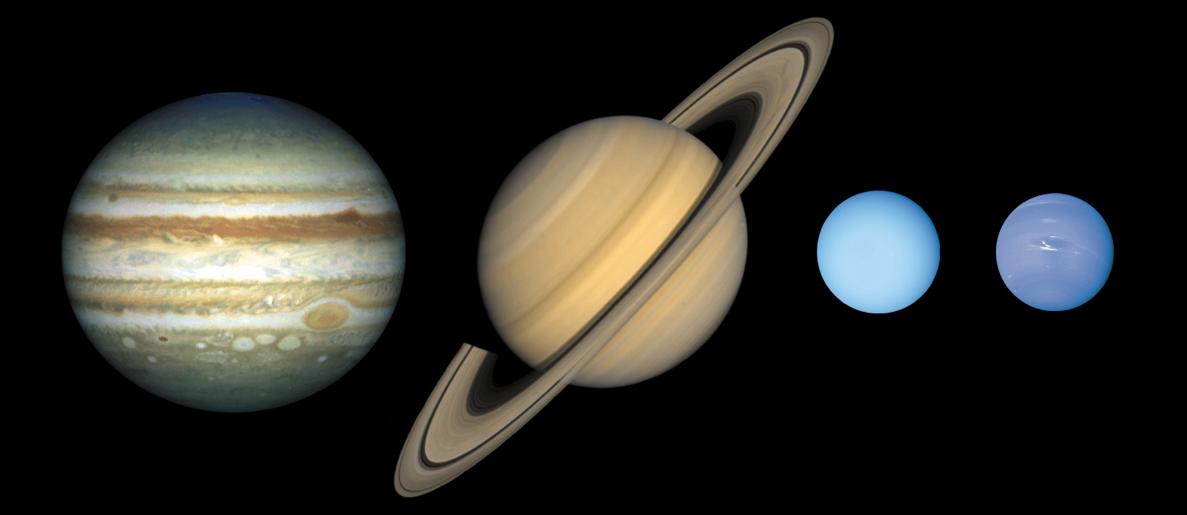
Jupiter, Saturn, Uranus, Neptune are the outer planets known as gas giants as they are composed mainly of gases and liquids.

Slide 8
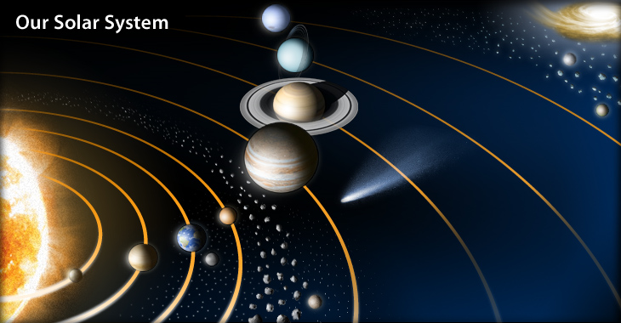
The solar system consists of the Sun and all celestial objects that revolve around it (planets, moons, asteroids, comets etc)

Slide 9
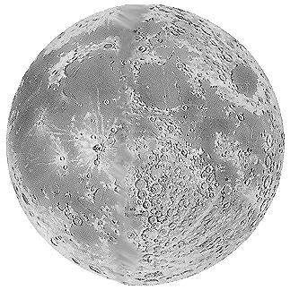
A satellite is a celestial object that revolves around a planet in a closed path or orbit.
Earth has one satellite called “Moon”
Planets can have no satellites or several satellites.
Jupiter and Saturn have over 60 each.
Our Moon is non-luminous (reflects light) and though it appears to be the largest/brightest celestial object in the sky, it is small compared to planets and stars.
Its average distance from Earth is 384,000 km.

Slide 10
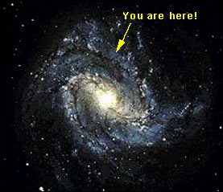
A galaxy is a huge, rotating collection of gas, dust and billions of stars, planets and other celestial objects.
Our planet and solar system are a part of the Milky Way Galaxy.
It contains more than
200 billion stars,
including the Sun and
what seems an infinite
number of celestials
objects.

Slide 11
