Slide 1
Motions of Earth, the Moon, and Planets

Slide 2
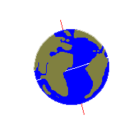
Earth’s Rotation
Earth rotates on its axis, it is a similar motion to the spinning of a top
Completes one rotation each day in a west to east direction

Slide 3
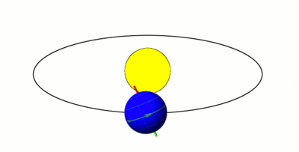
Earth’s Revolution and Planetary Orbits
Earth and other planets revolve around the Sun in an elliptical path

Slide 4
Orbital radius: the average distance between an object in the solar system and the sun
Earth’s orbital radius changes as it completes its orbit
Orbital period: time it takes to complete a revolution; approximately 365.25 days for Earth
Orbital period depends on size, shape, and distance from the sun

Slide 5
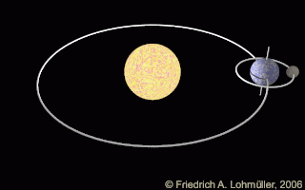
Motion of the Moon
Moon rotates on its axis and revolves around Earth
Time it takes for the moon to rotate and revolve is the same which means that Earth always sees the same side of the moon

Slide 6
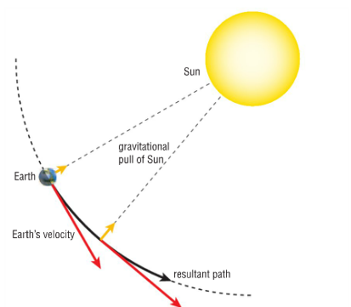
Gravitational force: the force of attraction between all masses in the Universe
Greater mass = stronger gravity
Gravity is what allows Earth to orbit around the sun and the Moon to orbit around the Earth

Slide 7
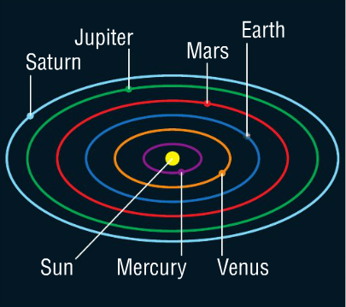
Solar System Models
Heliocentric model
Model that shows Earth and other planets revolve around the Sun

Slide 8
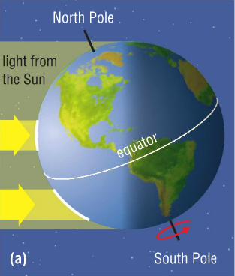
Earth’s Tilt
Earth’s axis is tilted 23.5º from the vertical
Earth’s tilt causes the change in seasons:
When Earth is tilted towards the sun; in the northern hemisphere sunlight spreads over a smaller area so there is intense heating of the surface

Slide 9
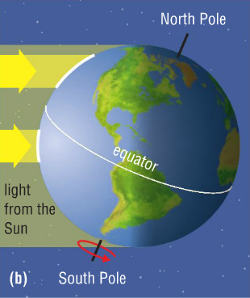
Earth’s Tilt
When Earth is tilted away from the sun; in the northern hemisphere sunlight spreads over a larger area so there is less heating of the surface
The opposite happens for the southern hemisphere

Slide 10
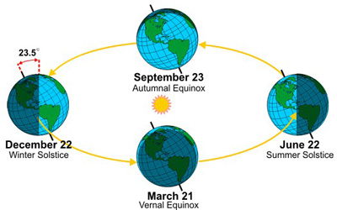
Solstice: an event that occurs two times each year, when the tilt of Earth’s axis is most inclined toward or away from the Sun
Equinox: the time of the year when the hours of daylight equals the hours of darkness

Slide 11
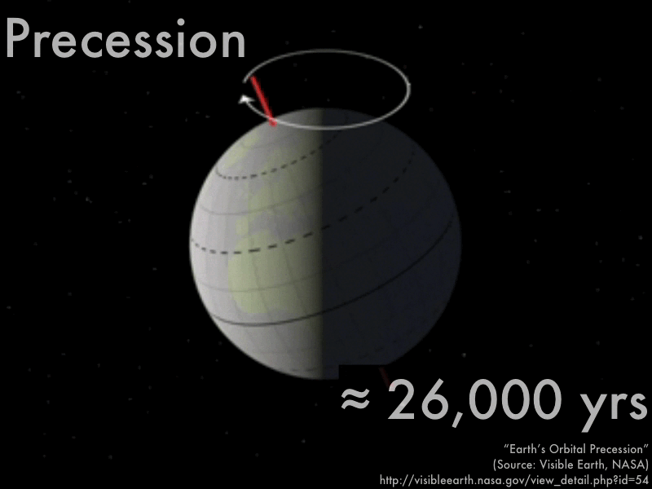
Precession
Precession: the changing direction of earth’s axis
As earth rotates on its axis, is wobbles thus the axis points in a different direction ever 26,000 years

Slide 12
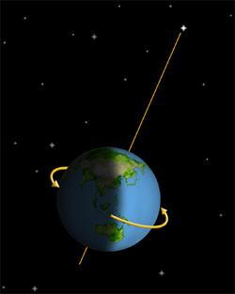
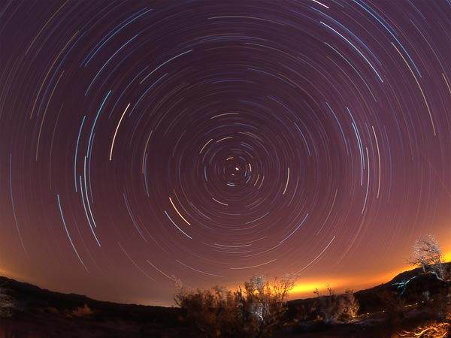
Polaris or the North Star is a star that appears to stay fixed in the sky (we appear to revolve around this star).
North star changes because of precession

Slide 13
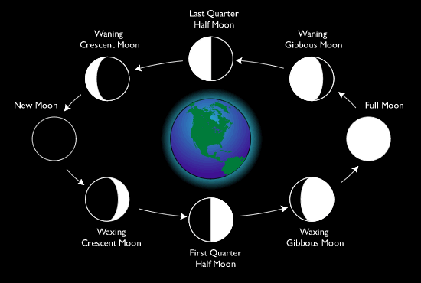
Phases of the Moon
Lunar cycle: all the phases of the moon over a period of about 4 weeks

Slide 14
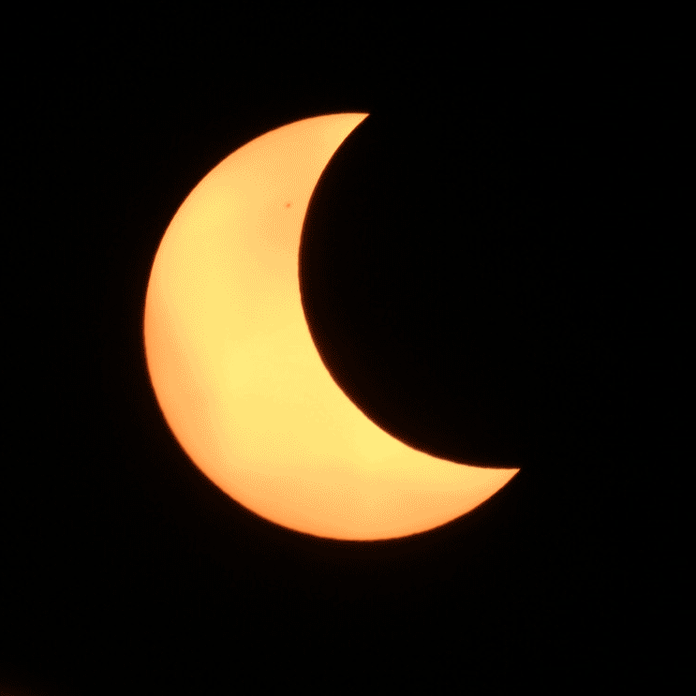
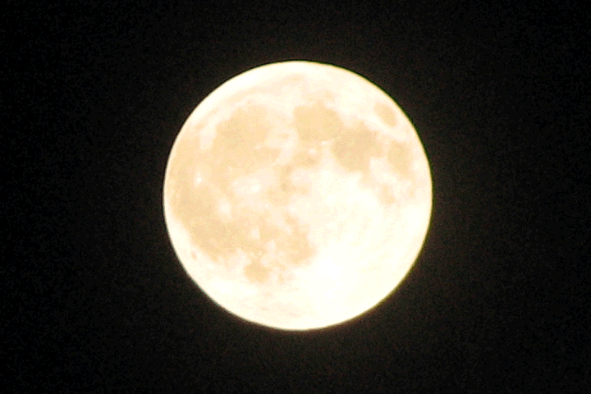
Eclipses
Eclipse: a darkening of a celestial object due to the position of another celestial object

Slide 15
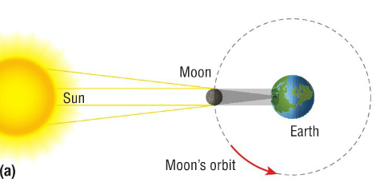
Solar eclipse
When moon is between Earth and Sun; Only possible during the new moon phase
Total solar eclipse: can see the outer atmosphere of the Sun and the corona
Partial solar eclipse: Moon does not cover the entire sun

Slide 16
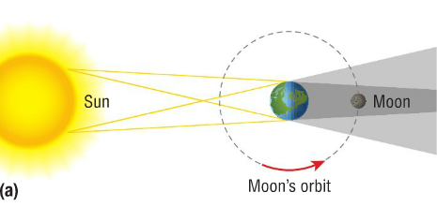
Lunar eclipse
When Earth is between Sun and Moon; can appear orange or red
Total lunar eclipse: entire moon is in Earth’s shadow
Partial lunar eclipse: only part of the Moon is in earth’s shadow

Slide 17
Tides
Tide: the alternate rising and falling of the surface of large bodies of water; caused by the interaction between Earth, the Moon, and the Sun
Moon’s gravitational force pulls Earth and the oceans towards it causing high tides
Time between tides is approximately 6 hours

Slide 18
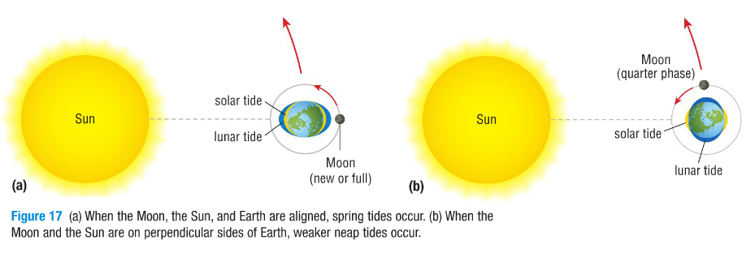
During new and full moon phases there are very high tides called spring tides
During quarter phases there are weaker tides called neap tides

Slide 19
8.6 Patterns in the Night Sky

Slide 20
Constellations
Constellation: a grouping of stars as observed from Earth
There are 88 constellations recognized by the International Astronomical Union

Slide 21
Stars move over many years so the images of constellations change slightly

Slide 22
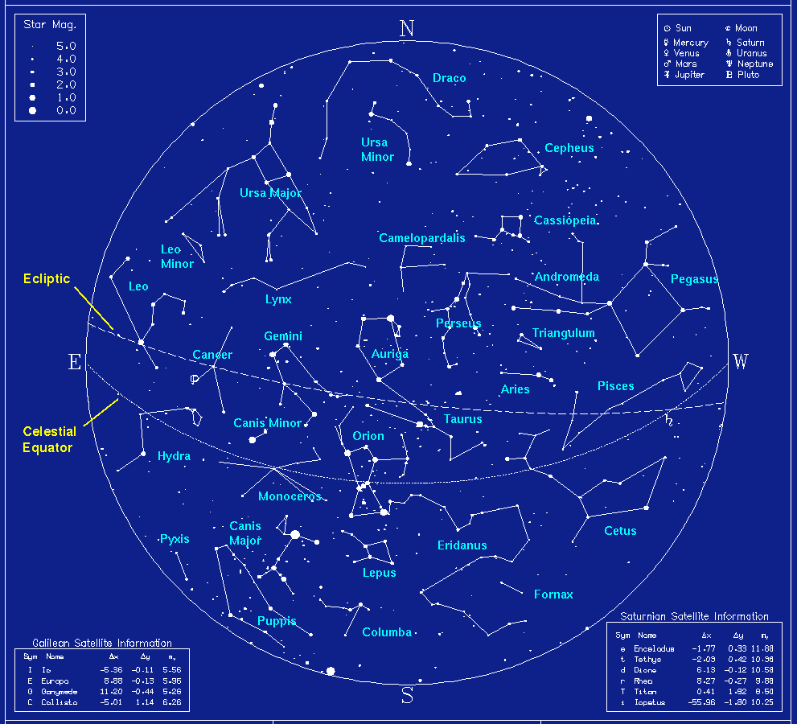
Star maps: maps which show the stars in a certain region of the sky, used for navigation

Slide 23
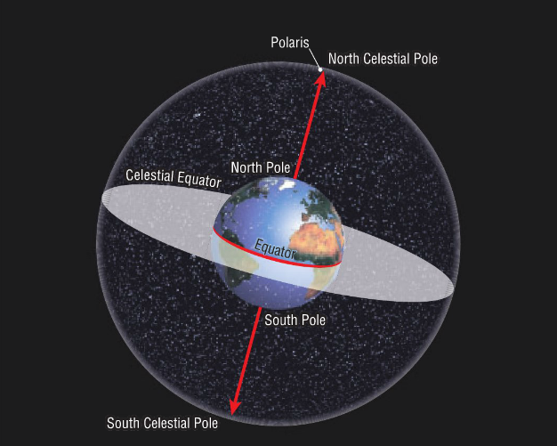
Celestial Sphere
Celestial sphere: the imaginary sphere that rotates around Earth
Divided into north and south hemispheres and has a celestial equator

Slide 24
Celestial navigation: the use of positions of stars to determine location and direction when travelling
Calendars developed by observing the sky were used to time agricultural and religious events and predict movement of the Sun, Moon, and eclipses Ex. Stonehenge in England

